Slide 1
PORTABLE FIRE EXTINGUISHER TRAINING
Notes:
Screen for arrival

Slide 2
Introduction
This training course was designed to familiarize the employees with the proper identification , selection and safe use of the portable fire extinguishers in the workplace. During this training, many topics will be addressed, from the definition of combustion; the classification of fires; proper extinguisher selection; proper use of a portable extinguisher, and the problems that can be quickly identified on a day-to-day basis to ensure an extinguisher will function effectively in the event of a fire emergency.
Notes:
HSMC Representative to present this section:
This training course was designed to familiarize the employees with the proper identification , selection and safe use of the portable fire extinguishers in the workplace. During this course many topics will be addressed, from the definition of combustion; the classification of fires; proper extinguisher selection; proper use of a portable extinguisher, and the problems that can be quickly identified on a day-to-day basis to ensure an extinguisher will function effectively in the event of a fire emergency.

Slide 3

Agenda
8:30 a.m. – 11:00 p.m. Theory Training & Questions
11:00 a.m. – 12:00 p.m. VR Simulation: Paper Fire
12:00 p.m. – 1:00 p.m. Break for Lunch
1:00 p.m. – 2:00 p.m. VR Simulation: Grease and Electrical Fire
2:00 p.m. – 3:30 p.m. Theory Training
3:30 p.m. – 4:00 p.m. Questions & Feedback
4:00 pm. – 4:30 p.m. Quiz
Notes:
HSMC Representative to present this section

Slide 4

Brendan van Dreumel
Full-Time Firefighter with Vaughan since January 2022. Stationed at a hazmat specialty hall for 2 years, now stationed at a heavy-rescue hall.
Part-Time Firefighter with Milton since May 2018. Promoted to Lieutenant in early 2024.
Worked in Hazardous Materials industry as an Emergency Responder from 2019-2022

Slide 5
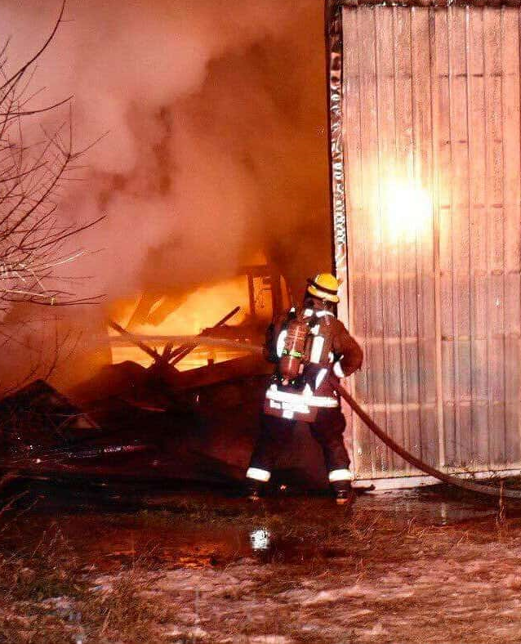
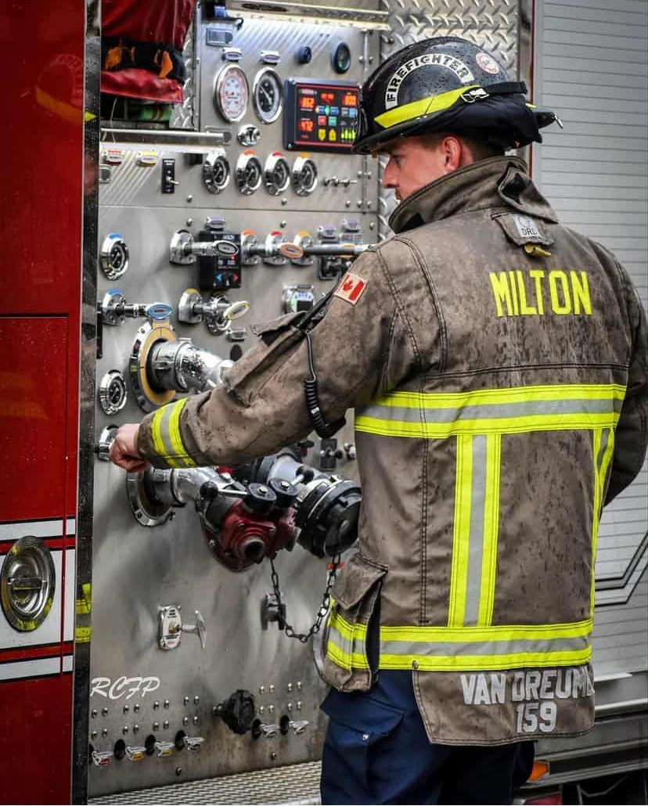
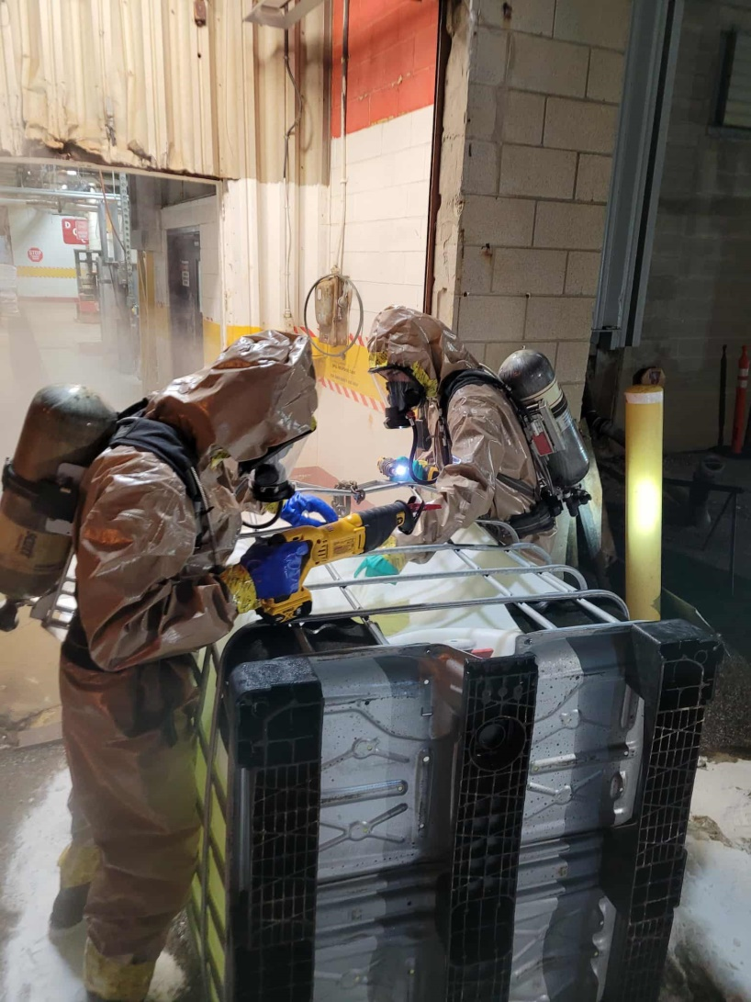
Brendan van Dreumel

Slide 6

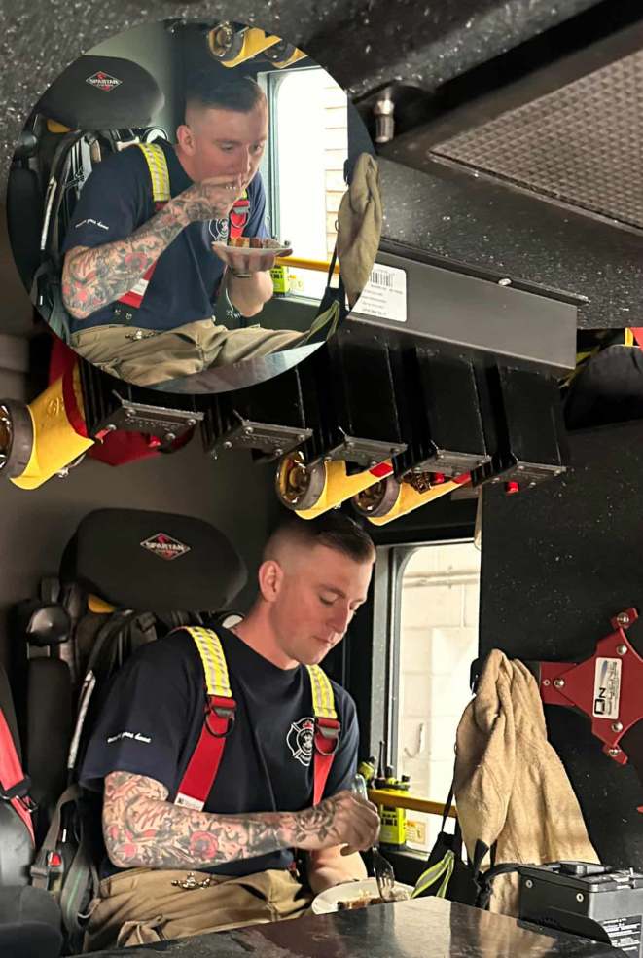
Brendan van Dreumel

Slide 7
Theory Training Outline
Section 1 Basic Overview of Combustion
Section 2 The Theory of Fire & Fire Growth
Section 3 Classification of Fire
Section 4 Common Types of Fire Extinguishers
Section 5 The Rules for Fighting Fires
Section 6 Fire Extinguisher Use
Section 7 Fire Extinguisher Inspection
Section 8 Evacuation Procedures
Section 9 Best Practices

Slide 8
Section 1
A Basic Overview of Combustion
Notes:
Screen for arrival

Slide 9
What is fire?

Slide 10
1. A Basic Overview of Combustion
Fire results from a chemical reaction between oxygen and some sort of fuel source - fast oxidization.
Fire does not spontaneously occur
The fuel source must be heated to its ignition temperature. That will vary depending on the fuel source.
This reaction is persistent and relentless because fire is self-perpetuating.
Notes:
Typically , fire results from a chemical reaction between oxygen and some sort of fuel source (Obviously, wood, paper, petroleum, propane, etc.) – this reaction is known as fast oxidization.
Obviously, fire does not spontaneously occur just because a fuel source is naturally surrounded by oxygen in the air.
For the chemical reaction to take place, the fuel source must be heated to its ignition temperature. That will vary depending on the fuel source involved.
What makes the chemical reactions involved in fire persistent and relentless is the face that fire is self-perpetuating.
Self Perpetuating: Capable of continuing or renewing one’s self indefinitely

Slide 11
1. A Basic Overview of Combustion
Fire will continue to burn as long as the fuel and oxygen remain present to sustain it.
By-products combustion: energy (heat), light (“incandescence”) and smoke (compounds of hydrogen, carbon & oxygen).
“Char”- nearly pure carbon; and “Ash” – unburnable minerals such as potassium, calcium, etc.
Toxins: Carbon Monoxide (CO) and Hydrogen Cyanide (HCN), among others.
Notes:
The heat of the resulting combustion keeps the fuel source at or beyond its combustion temperature, the fire will continue to burn as long as the fuel and oxygen remain present to sustain it.
The chemical reactions involved in fire also create by-products combustion: energy (heat), light (“incandescence”) and smoke (compounds of hydrogen, carbon & oxygen).
Other by-products of fire include: “char”- nearly pure carbon; and “ash” – unburnable minerals such as potassium, calcium, etc.
Certain toxins may also be produced as a by-product of some burning fuels. Example: toxic gases such as Carbon Monoxide (CO) and Hydrogen Cyanide (HCN), among others.

Slide 12
1. A Basic Overview of Combustion
Fire will burn until something interrupts the chemical reaction.
Typically, either fuel or oxygen will deplete entirely before the chemical reaction naturally ends.
Extinguishers are designed to interrupt the chemical reaction and stop the spread of fire far earlier than its natural extinguishment.
Fire extinguishers will use 1 of 3 methods to stop the chemical reaction.
Notes:
In short, the fire will burn until something interrupts the chemical reaction.
If the chemical reaction is left alone, typically either fuel or oxygen will deplete entirely before the chemical reaction ceases.
Extinguishers are designed to interrupt the chemical reaction, and stop the spread of fire far earlier than it’s natural extinguishment.
This can be done in 4 ways, however fire extinguishers will use 1 of 3 methods to stop the chemical reaction.

Slide 13
1. A Basic Overview of Combustion
Summary:
What is fire?
A self perpetuating chemical reaction between oxygen and a fuel source, caused by heating the fuel to it’s ignition temperature.
What are the 3 products of combustion?
Heat, light, and smoke
What stops the chemical reaction?
Either the fuel or oxygen sustaining the reaction depletes, or something interrupts the chemical reaction
Notes:
Welcome Slide (Animated)

Slide 14
Section 2
The Theory of Fire
Notes:
Screen for arrival

Slide 15
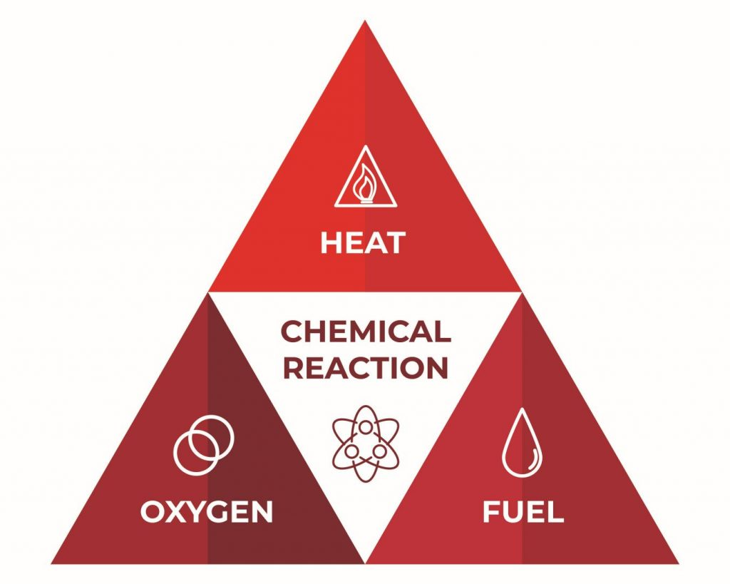
2. The Theory of Fire
Fire Science uses the Fire Tetrahedron to represent the four required elements (fuel, heat, oxygen, uninhibited chemical chain reaction) that must be present for the combustion process to occur.
Notes:
Fire Science uses the Fire Tetrahedron to represent the four required elements (fuel, heat, oxygen, uninhibited chemical chain reaction) that must be present for the combustion process to occur.

Slide 16
2. The Theory of Fire
Fuel + Oxidizing Agent + Heat = Fire
Represented by a series of uninhibited chemical chain reactions that convert the fuel and oxygen components into products of combustion and energy.
The energy is released in the form of heat and light; AKA fire.
By this theory, common fires may be extinguished in one of four ways:
Notes:
As fuel is brought together with an oxidizing agent, and the fuel is raised above its ignition temperature, a fire will result.
The combination process is represented by a series of uninhibited chemical chain reactions that convert the fuel and oxygen components into products of combustion and energy.
The energy is released in the form of heat and light; or what is commonly recognized as fire.
By this theory, common fires may be extinguished in one of four ways:

Slide 17
2. The Theory of Fire
Removing the Fuel: Separate the fuel from interaction with oxygen to stop combustion.
Examples:
Closing a valve to stop the flow of flammable liquid or gas on a fire.
Using fire-retardant coatings or paints on combustible material.
Cooling: The removal of heat from a fire cools the fuel below its ignition temperature (“flash point”) resulting in the extinguishment of the fire.
Examples:
Water can be used to cool a burning wood fire.
An inert gas such as carbon dioxide produces “snow” as a cooling agent when propelled from a compressed canister.
Notes:
1: Removing the Fuel: The fuel component supports combustion. In a fire scenario, the fuel is not literally removed but is actually separated from interaction with oxygen(or oxidizing agent) to stop combustion. Examples of this are:
Closing a valve to stop the flow of flammable liquid or gas on a fire.
Using fire-retardant coatings or paints on combustible material.
2: Cooling: Combustion will occur when a material is heated above it s ignition temperature. The removal of heat from a fire cools the fuel below its ignition temperature (“flash point”) resulting in the extinguishment of the fire. Examples of this are:
Water can be used to cool a burning wood fire.
An inert gas such as carbon dioxide produces “snow” as a cooling agent when propelled from a compressed canister.

Slide 18
2. The Theory of Fire
Smothering or Suffocating: When the oxidizing agent is removed or separated from the fuel source, combustion cannot be sustained. Examples:
Venting the air from a fire located in an unoccupied storage vault.
Foaming agents float atop burning liquids restricting oxygen in the air from sustaining the fire.
Disrupting the Chemical Chain Reaction, or Interrupting the Flame: When the reaction between the three elements is stopped or interrupted, combustion cannot occur. Examples of this are:
Fine particles from a dry chemical extinguisher (Sodium Bicarbonate-NaHCO³, Potassium Bicarbonate-KHCO³ or Mono-Ammonium Phosphate-[NH⁴]H²PO⁴) are inert solids that react with the products of combustion released during fast oxidation; thereby interrupting the chemical reaction.
Non-oxidizing gases or “clean agents” change the composition of oxygen chemically, thereby interrupting the chemical reaction.
Notes:
3: Smothering or Suffocating: Oxygen, or the presence of an oxidizing agent, sustains combustion. When the oxidizing agent is removed or separated from the fuel source, combustion cannot be sustained. Examples are as follows:
Venting the air from a fire located in an unoccupied storage vault.
Foaming agents float atop burning liquids restricting oxygen in the air from sustaining the fire.
4: Disrupting the Chemical Chain Reaction, or Interrupting the Flame: When the reaction between the three elements is stopped or interrupted, combustion cannot occur. Examples of this are:
Fine particles from a dry chemical extinguisher (Sodium Bicarbonate-NaHCO³, Potassium Bicarbonate-KHCO³ or Mono-Ammonium Phosphate-[NH⁴]H²PO⁴) are inert solids that react with the products of combustion released during fast oxidation; thereby interrupting the chemical reaction.
Non-oxidizing gases or “clean agents” change the composition of oxygen chemically, thereby interrupting the chemical reaction.

Slide 19
2. The Theory of Fire
Fire Growth: There are 4 stages to fire growth
Incipient
Growth
Fully Involved
Decay
Notes:
Imagine this:
You’ve built a camp fire, and now your task is to light it. You stuff old newspaper under some small twigs (kindling), with some larger sticks stacked on top of that. In a nice neat teepee above all of this are your dry, thick logs that will last for most of the night.
You start with bringing a lighter to the newspaper. The newspaper catches, and within 10 seconds most of pages 15-17 of the Toronto Sun have starting flaming.
You notice the fire has now caught your kindling and small twigs. Perfect! Your fire is seated and is gradually heating the next layer of your fuel– the sticks. Eventually, those start to catch as you open up a package of marshmallows.
After a while the combination of your newspaper, kindling, twigs, and sticks have heated up the logs enough to catch those as well. You’re in business!
As your logs are burning, you lean back with your marshmallow on a stick and enjoy your fire. It won’t need much attention from here.

Slide 20
2. The Theory of Fire
1. Incipient
The beginning stages of the fire. At this point, there is enough heat to bring a material past it’s ignition temperature and begin the self-sustaining chemical reaction that is fire. There is heat and a reaction, and enough fuel and oxygen to allow for growth.
A fire extinguisher will stop this stage of fire growth safely.
2. Growth
The chemical reaction is self sustaining and has enough fuel and oxygen, and heat is being produced by the chemical reaction (fire). It will continue to grow until at least one part of the chemical reaction is interrupted!
This will be the limit of a fire extinguishers capabilities and they will often be ineffective!
Notes:
1. Incipient
The beginning stages of the fire. At this point, there is enough heat to bring a material past it’s ignition temperature and begin the self-sustaining chemical reaction that is fire. There is heat and a reaction, and enough fuel and oxygen to allow for growth.
A fire extinguisher will stop this stage of fire growth safely.
2. Growth
The chemical reaction is self sustaining and has everything in the fire tetrahedron it needs to continue growing. It has enough fuel and oxygen, and heat is being produced by the chemical reaction (fire). It will continue to grow until at least one part of the chemical reaction is interrupted!
This will be the limit of a fire extinguishers capabilities, depending on the amount of fuel and the intensity of the fire.

Slide 21
2. The Theory of Fire
3. Fully Involved
This is the climax of the fire. At this stage, it is limited by 1 of 2 things: fuel or oxygen.
This stage will last as long as there is fuel or oxygen. The fire will be either fuel-limited or oxygen-limited, depending on what the chemical reaction will lose access to first.
This will have to be handled by the fire department.
4. Decay
The fire has now run out of either fuel or oxygen and is starting to whither.
If it is an oxygen-limited fire, introducing oxygen to the fire (i.e. opening a door) can cause it to reverse back to fully involved or growth.
Notes:
3. Fully Involved
This is the climax of the fire. At this stage, it is limited by 1 of 2 things: fuel or oxygen.
In a structure fire, everything in a room will be burning or about to burn. This stage will last as long as there is fuel or oxygen. The fire will be either fuel-limited or oxygen-limited, depending on what the chemical reaction will lose access to first.
A fire extinguisher will typically not make a dent in a fire like this and it will have to be handled by the fire department.
4. Decay
The fire has now run out of either fuel or oxygen and is starting to whither.
If it is an oxygen-limited fire, this can be dangerous as introducing oxygen to the fire (i.e. opening a door) can cause it to reverse back to fully involved or growth.

Slide 22
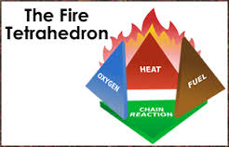
2. The Theory of Fire
Summary
Fire Science is modeled around the Fire Tetrahedron. All 4 factors must be present for a fire to burn.
There are 4 ways to extinguish a fire, each removing one part of the fire tetrahedron: Removing the fuel, Cooling, Smothering, and Interrupting the Chemical Chain Reaction. Fire Extinguisher’s are designed to remove at least 1 of these parts.
There are 4 stages to fire growth: Incipient, Growth, Fully Involved, and Decay. Fire extinguishers are designed for the incipient stage of a fire, and can be used for some growth stage fires.
Notes:
Welcome Slide (Animated)

Slide 23
Section 3
Classification of Fire
Notes:
Screen for arrival

Slide 24
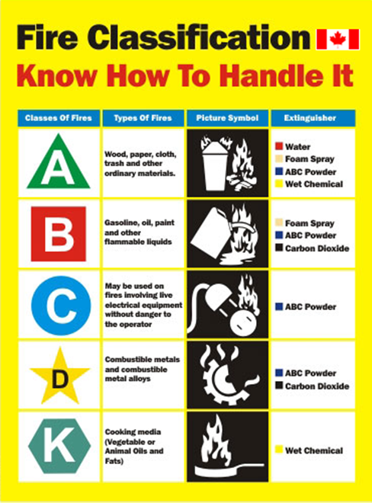
3. Classification of Fire
There are several classifications of fire based of the type of fuel burning and the characteristics of resulting fire.
Each class can have very different hazards and may require a different method of extinguishment.
Fires are classified in to:
Class A
Class B
Class C
Class D
Class K

Slide 25
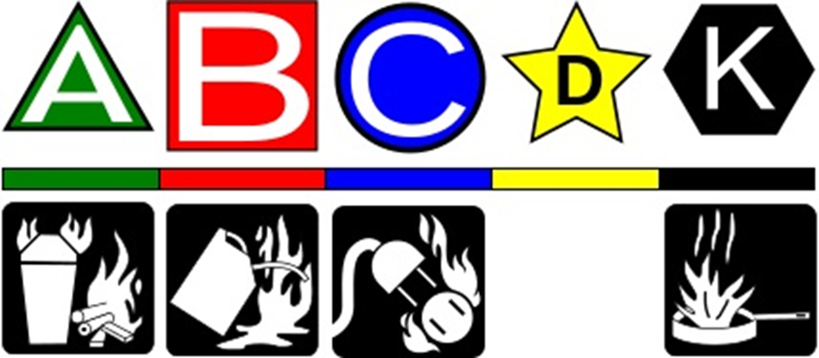
3. Classification of Fire
Each class of fire uses a symbol specific to it’s class and fire extinguishers will be labelled with these symbols.

Slide 26






3. Classification of Fire
Class A Fires
Fires in ordinary combustible materials commonly seen in your everyday life.
Wood, cloth, paper, rubber, and many plastics.
Class B Fires
Fires that occur in flammable and combustible liquids (fuel, alcohols, etc.) as well as flammable gases.
*Flammable liquid fires occur in the vapour-air mixture above the surface, and not in the liquid itself.
Class C Fires
Fires that involve energized electrical equipment where non-conducting extinguishing agents must be used.
The Class C designation refers to the source of ignition and not to the fuel as is the case with the other four classes.
Once you de-energize equipment, class A & B extinguishers can be used safely
Notes:
Class A Fires
Fires in ordinary combustible materials commonly seen in your everyday life.
Wood, cloth, paper, rubber, and many plastics.
Class B Fires
Fires that occur in flammable and combustible liquids (petroleum greases, tars, oils, oil-based paints, solvents, lacquers, alcohols) as well as flammable gases.
*Flammable liquid fires occur in the vapour-air mixture above the surface, and not in the liquid itself.
Class C Fires
Fires that involve energized electrical equipment where non-conducting extinguishing agents must be used. The Class C designation refers to the source of ignition and not to the fuel as is the case with the other four classes.
When able, an attempt should always be made to de-energize equipment before fighting a Class C Fire. When electrical equipment is de-energized, fire extinguishers for Class A or Class B fires may then be used safely.

Slide 27



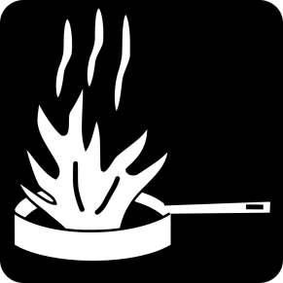
3. Classification of Fire
Class D Fires
Fires that occur in combustible metals such as: magnesium, titanium, zirconium, sodium, lithium, and aluminum.
Specialized techniques, extinguishing agents, and extinguishing equipment have been developed to control and extinguish fires of this type.
Extinguishing agents not rated for D-Class hazards must NEVER be used. Metals burn at an extremely high temperature and will react violently water.
Class K Fires
Fires in cooking appliances that involve; Combustible cooking media (vegetable or animal oils and fats).
Grease fires react violently with water!
UL (Underwriters Laboratories) testing requires that a Class K fire be completely extinguished prohibiting re-ignition of the cooking substance involved for a minimum 20 minutes.
Notes:
Class D Fires
Fires that occur in combustible metals such as: magnesium, titanium, zirconium, sodium, lithium, and aluminum.
Specialized techniques, extinguishing agents, and extinguishing equipment have been developed to control and extinguish fires of this type. Since burning metal produces such a high temperature, Extinguishing agents not rated for D-Call hazards must NEVER be used since metal fires. Burning metal at such high temperatures will react violently with water, air and/or other chemicals.
Class K Fires
Fires in cooking appliances that involve; Combustible cooking media (vegetable or animal oils and fats).
Grease fires react violently with water!
UL (Underwriters Laboratories) testing requires that a Class K fire be completely extinguished prohibiting re-ignition of the cooking substance involved for a minimum 20 minutes, or until the temperature decreases to at least 60°F below the ignition temperature, whichever is longer.

Slide 28
3. Classification of Fire
Summary
Fires are classified in to 5 categories depending on the type of fuel burning:
Class A: Ordinary Combustibles
Class B: Flammable Liquids
Class C: Electrical Fires
Class D: Combustible Metals
Class K: Kitchen/Grease Fires
*Class C fires can turn in to A or B fires once de-energized
Each class has a symbol attached to it. Fire extinguishers are to be labelled with the symbol appropriate for the class of fire it is designed to extinguish

Slide 29
Section 4
Common Types of Fire Extinguishers
Notes:
Screen for arrival

Slide 30
4. Common Types of Fire Extinguishers
There are several types of extinguishers designed for combating 1 or several of the fire classes.
Each extinguisher will use a different extinguishing agent to interrupt the fire’s chemical reaction.
Using the wrong extinguisher for the fuel type burning can have disastrous consequences.
Notes:
There are several types of extinguishers designed for combating 1 or several of the fire classes.
Each extinguisher will use a different extinguishing agent to interrupt the fire’s chemical reaction, and the type of agent used dictates the class of fire it’s designed to extinguish.
Using the wrong extinguisher for the fuel type burning can have disastrous consequences. For example, using a Class A (ordinary combustibles) on a class K fire will cause a violent reaction

Slide 31
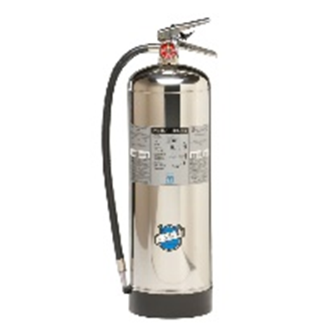
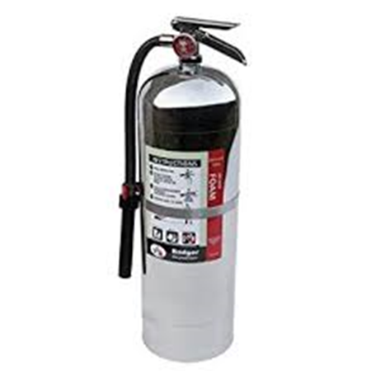
4. Common Types of Fire Extinguishers
Water and Foam: Fire extinguishers extinguish the fire by taking away the heat element of the fire triangle. Foam agents also separate the oxygen from other elements. (Cooling & Smothering)
Water Extinguishers: Class A fires only - they should not be used on Class B or C fires as it could spread the fire or shock you.
Notes:
Water and Foam: Fire extinguishers extinguish the fire by taking away the heat element of the fire triangle. Foam agents also separate the oxygen from other elements. They can be used for Class A fires and B fires if labelled as such.
Water Extinguishers: Class A fires only - they should not be used on Class B or C fires. The discharge stream could spread the flammable liquid in a Class B fire or could create a shock hazard on a class C fire.

Slide 32
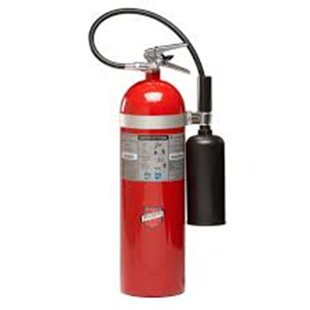
4. Common Types of Fire Extinguishers
Carbon Dioxide: Extinguish the fire by taking away the oxygen element of the fire triangle and by removing the heat with a very cold discharge.
*Do not touch the nozzle after use!
Used on class B & C fires
Notes:
Carbon Dioxide: Extinguish the fire by taking away the oxygen element of the fire triangle and also by removing the heat with a very cold discharge. *Do not touch the nozzle after use! Carbon dioxide can be used on Class B & C fires. They are usually ineffective on Class A fires.

Slide 33
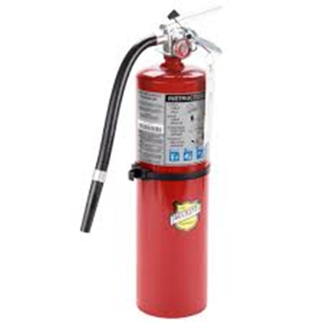
4. Common Types of Fire Extinguishers
Dry Chemical:
Interrupts the chemical reaction part of the fire triangle.
Today's most widely used type of fire extinguisher, it’s effective on Class A, B and C fires.
Agent works by creating a barrier between the oxygen and the fuel elements of Class A fires (smothering).
Ordinary dry chemical is for Class B & C fires only. Using the incorrect agent can allow the fire to reignite after apparently being extinguished successfully.
Notes:
Dry Chemical:
Extinguish the fire primarily by interrupting the chemical reaction of the fire triangle. Today's most widely used type of fire extinguisher is the multipurpose dry chemical that is effective on Class A, B and C fires. This agent also works by creating a barrier between the oxygen element and the fuel element on Class A fires.
Ordinary dry chemical is for Class B & C fires only. It is important to use the correct extinguisher for the type of fuel! Using the incorrect agent can allow the fire to reignite after apparently being extinguished successfully.

Slide 34
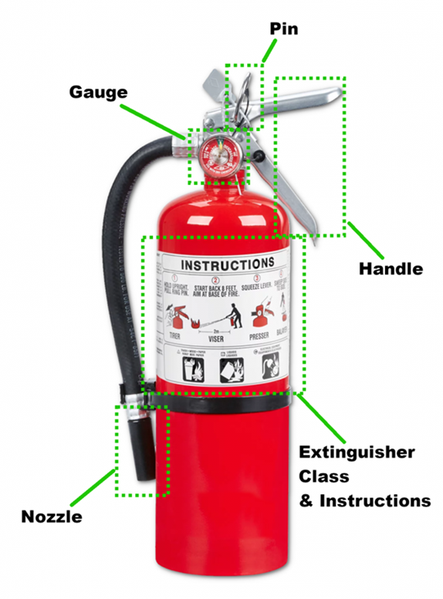
4. Common Types of Fire Extinguishers
Dry Chemical:
Interrupts the chemical reaction part of the fire triangle.
Today's most widely used type of fire extinguisher, it’s effective on Class A, B and C fires.
Agent works by creating a barrier between the oxygen and the fuel elements of Class A fires (smothering).
Ordinary dry chemical is for Class B & C fires only. Using the incorrect agent can allow the fire to reignite after apparently being extinguished successfully.
Notes:
Dry Chemical:
Extinguish the fire primarily by interrupting the chemical reaction of the fire triangle. Today's most widely used type of fire extinguisher is the multipurpose dry chemical that is effective on Class A, B and C fires. This agent also works by creating a barrier between the oxygen element and the fuel element on Class A fires.
Ordinary dry chemical is for Class B & C fires only. It is important to use the correct extinguisher for the type of fuel! Using the incorrect agent can allow the fire to reignite after apparently being extinguished successfully.

Slide 35
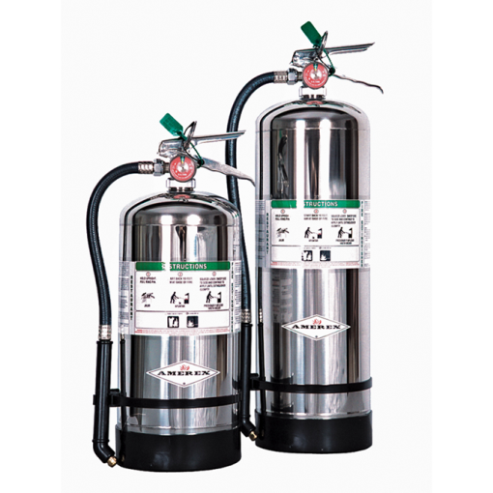
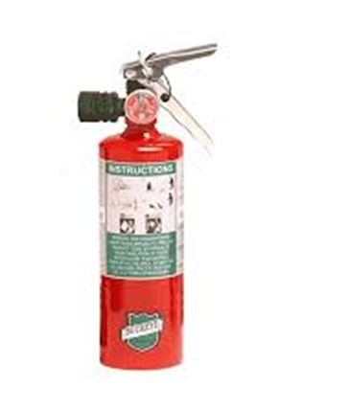
4. Common Types of Fire Extinguishers
Wet Chemical: A new agent that extinguishes the fire by removing the heat of the fire triangle creates a barrier between the oxygen and fuel elements. (cooling & smothering)
Wet chemical or Class K extinguishers were deep fat fryers in commercial cooking operations. Some may be used on Class A fires in commercial kitchens.
Halogenated or Clean Agent: Include the halon agents as well as the newer halocarbon agents. They interrupt the chemical reaction of the fire triangle. Primarily for Class B & C fires. Some larger clean agent extinguishers can be used on Class A, B and C fires.
Notes:
Wet Chemical: A new agent that extinguishes the fire by removing the heat of the fire triangle and prevents reigniting by creating a barrier between the oxygen and fuel elements.
Wet chemical or Class K extinguishers were developed for modern, high efficiency deep fat fryers in commercial cooking operations. Some may also be used on Class A fires in commercial kitchens.
Halogenated or Clean Agent: Include the halon agents as well as the newer and less ozone depleting halocarbon agents. They extinguish the fire by interrupting the chemical reaction of the fire triangle. Clean agent extinguishers are primarily for Class B & C fires. Some larger clean agent extinguishers can be used on Class A, B and C fires.

Slide 36
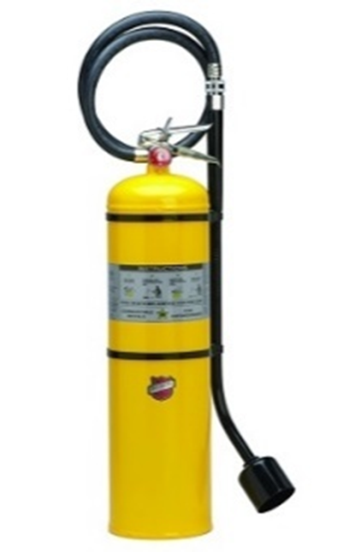
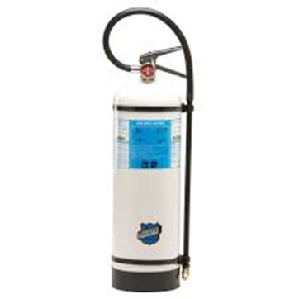
4. Common Types of Fire Extinguishers
Dry Powder: Extinguish the fire by separating the fuel from the oxygen element or by removing the heat element of the fire triangle.
Dry powder extinguishers are for Class D fires only. They are ineffective on all other classes of fires. Remember: Many class D fires react violently with water and other substances!
Water Mist: A recent development that extinguishes the fire by taking away the heat element of the fire triangle. Used where contamination is a concern. Water mist extinguishers are primarily for Class A fires, although they are safe for use on Class C fires as well.
Notes:
Dry Powder: Similar to dry chemical except that they extinguish the fire by separating the fuel from the oxygen element or by removing the heat element of the fire triangle. However, dry powder extinguishers are for Class D or combustible metal fires, only. They are ineffective on all other classes of fires. Remember: Many class D fires react violently with water and other substances!
Water Mist: A recent development that extinguishes the fire by taking away the heat element of the fire triangle. They are an alternative to the clean agent extinguishers where contamination is a concern. Water mist extinguishers are primarily for Class A fires, although they are safe for use on Class C fires as well. There is not enough water to conduct electricity.

Slide 37
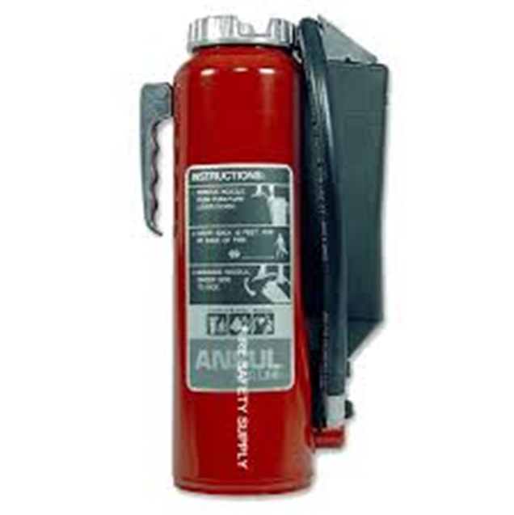
4. Common Types of Fire Extinguishers
Cartridge Operated Dry Chemical:
Extinguish the fire by interrupting the chemical reaction of the fire triangle.
Multipurpose dry chemical is effective on Class A, B and C fires. It Works by creating a barrier between the oxygen element and the fuel element on Class A fires (smothering).
Ordinary dry chemical is for Class B & C fires only. Using the incorrect agent can allow the fire to re-ignite.
Notes:
Cartridge Operated Dry Chemical:
Extinguish the fire primarily by interrupting the chemical reaction of the fire triangle.
Like the stored pressure dry chemical extinguishers, the multipurpose dry chemical is effective on Class A, B and C fires. This agent also works by creating a barrier between the oxygen element and the fuel element on Class A fires.
Ordinary dry chemical is for Class B & C fires only. It is important to use the correct extinguisher for the type of fuel! Using the incorrect agent can allow the fire to re-ignite after apparently being extinguished successfully.

Slide 38
4. Common Types of Fire Extinguishers
Summary
There are many different types of extinguishers, some more common than others.
Extinguishers use a variety of extinguishing agents. Be sure to check the symbol labelled on the extinguisher to ensure it’s the correct class of fire you’re trying to extinguish.
The most common type is the modern “ABC” extinguisher, which uses a Dry Chemical agent to extinguish the fire.
If you use the wrong extinguisher, it could have ineffective or violent results!
Notes:
There are many different types of extinguishers, some more common than others.
Extinguishers use a variety of extinguishing agents. Be sure to check the symbol labelled on the extinguisher to ensure it’s the correct class of fire you’re trying to extinguish.
The most common type is the modern “ABC” extinguisher, which uses a Dry Chemical agent to extinguish the fire.
If you use the wrong extinguisher, it could have ineffective or violent results!

Slide 39
Section 5
Rules for Fighting Fires
Notes:
Screen for arrival

Slide 40
5. Rules for Fighting Fires
Fire is DANGEROUS!
YOUR safety is the FIRST thing to consider when dealing with a fire!
Just remember the three A's
Activate the building alarm system or notify the fire department by calling 911. Or, have someone else do this for you.
Assist any persons in immediate danger, or those incapable on their own, to exit the building, without risk to yourself.
Only after these two are completed, should you Attempt to extinguish the fire.
Activate
Assist
Attempt
Notes:
Fire is DANGEROUS!
The worst thing you can do when responding to an emergency is become a part of the problem.
YOUR safety is the FIRST thing to consider when dealing with a fire!
Just remember the three A's
Activate the building alarm system or notify the fire department by calling 911. Or, have someone else do this for you.
Assist any persons in immediate danger, or those incapable on their own, to exit the building, without risk to yourself.
Only after these two are completed, should you Attempt to extinguish the fire.

Slide 41
5. Rules for Fighting Fires
Only fight a fire if…
If the fire is small and contained. The incipient stage of the fire. Once the fire starts to grow, it’s best to evacuate the building closing doors or windows behind you.
If you are safe from toxic smoke. If there’s too much toxic smoke, don’t attempt to extinguish. Neither should you attempt to extinguish the fire in a confined space. Outdoors, approach with the wind at your back. All fires will produce carbon monoxide and many fires will produce toxic gasses that can be fatal even in small amounts.
If you have a means of escape. Have an exit or other means of escape at your back. If things don’t go your way, you need to be able to get out quickly and avoid becoming trapped.
If your instincts tell you it's ok. If you do not feel comfortable attempting to extinguish the fire, don't try - get out and let the fire department do their job.
Notes:
Only fight a fire if…
If the fire is small and contained. The time to use a fire extinguisher is in the early, or incipient, stage of a fire. Once the fire starts to grow or spread, it is best to evacuate the building, closing doors or windows behind you.
If you are safe from toxic smoke. If the fire is producing large amounts of thick, black smoke or chemical smoke, it may be best not to try to extinguish the fire. Neither should you attempt to extinguish the fire in a confined space. Outdoors, approach the fire with the wind at your back. Remember that all fires will produce carbon monoxide and many fires will produce toxic gasses that can be fatal, even in small amounts.
If you have a means of escape. You should always fight a fire with an exit or other means of escape at your back. If the fire is not quickly extinguished, you need to be able to get out quickly and avoid becoming trapped.
If your instincts tell you it's ok. If you do not feel comfortable attempting to extinguish the fire, don't try - get out and let the fire department do their job.

Slide 42
5. Rules for Fighting Fires
Summary
The three A’s:
Activate your buildings alarm system
Assist any persons in immediate danger without endangering yourself
Attempt to use an extinguisher remembering the rules for fighting fires
RULES FOR FIGHTING FIRES:
The fire is small and contained
You are safe from toxic smoke
You have a means of escape
Your instincts tell you it’s OK

Slide 43
Section 6
Fire Extinguisher Use
Notes:
Screen for arrival

Slide 44
6. Fire Extinguisher Use
Know the locations and the types of extinguishers in your workplace prior to actually using one.
Practice picking up and holding an extinguisher to get an idea of the weight and feel.
Read the operating instructions and warnings found on the fire extinguisher label.
Not all fire extinguishers look alike.
Practice releasing the discharge hose or horn and aiming the nozzle.
Do not pull the pin or squeeze the lever, this will break the seal and cause pressure loss.
Notes:
It is important to know the locations and the types of extinguishers in your workplace prior to actually using one.
Fire Extinguishers can be heavy, so it's a good idea to practice picking up and holding an extinguisher to get an idea of the weight and feel.
Take time to read the operating instructions and warnings found on the fire extinguisher label. Not all fire extinguishers look alike.
Practice releasing the discharge hose or horn and aiming it at the base of an imagined fire.
Do not pull the pin or squeeze the lever. This will break the extinguisher seal and cause it to lose pressure.

Slide 45
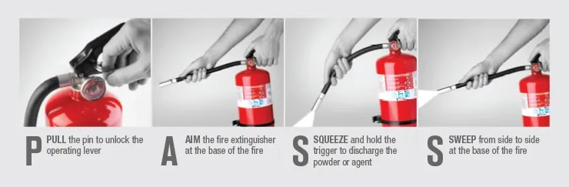
6. Fire Extinguisher Use
When it is time to use the extinguisher on a fire, just remember to P.A.S.S.!
Notes:
When it is time to use the extinguisher on a fire, just remember to P.A.S.S.!
Pull, Aim, Squeeze, Sweep
Pull- Pull the pin.
Aim- Aim the nozzle or hose at the base of the fire from the recommended safe distance.
Squeeze- Squeeze the operating lever to discharge the fire extinguisher agent.
Sweep- Starting at the recommended distance, sweep the nozzle or hose from side to side until the fire is out. Move forward or around the fire area as the fire diminishes. Watch the area in case of re-ignition.

Slide 46
6. Fire Extinguisher Use
Tips and Tricks:
Take a few breaths before acting!
Take a brief moment and assess the situation!
Check the gauge!
Check the label!
DO NOT aim for the flames themselves!
REMEMBER: Your safety comes first!
Notes:
Tips and Tricks:
Take a few breaths before acting. This will calm you down and reduce “tunnel vision”.
Take a brief moment and assess what is burning before you pull the pin. Make sure you’re confident that you know what classification of fire it is while gaining a basic understanding of the situation and factors that could affect your safety.
Check the gauge before operating to ensure it is charged , and once you pull the pin try put it in your pocket before using.
Be very mindful to check the label and ensure it is the correct extinguishing agent for the fire you are fighting.
DO NOT aim for the flames themselves as this will accomplish nothing.
REMEMBER: Your safety comes first!

Slide 47
6. Fire Extinguisher Use
Summary

Slide 48
Questions?

Slide 49

Paper Fire Simulation

Slide 50
Grease and Electrical
Fire Simulation

Slide 51
Section 7
Fire Extinguisher Inspection
Notes:
Screen for arrival

Slide 52
7. Fire Extinguisher Inspection
Fire extinguishers must be maintained on a regular basis to insure their proper operation.
The owner or occupant of the property are responsible for arranging fire extinguishers' maintenance.
Fire extinguishers must be inspected or given a "quick check" every 30 days.
Notes:
Like any mechanical device, fire extinguishers must be maintained on a regular basis to insure their proper operation.
You, the owner or occupant of the property where fire extinguishers are located, are responsible for arranging your fire extinguishers' maintenance.
Fire extinguishers must be inspected or given a "quick check" every 30 days.

Slide 53
7. Fire Extinguisher Inspection
For most extinguishers, the “quick check” can be accomplished by answering these questions:
Is the extinguisher in the correction location?
Is the tamper seal in place?
Is there any visible damage?
Is it visible and accessible?
Does the gauge or pressure indicator show the correct pressure?
For Carbon dioxide fire extinguishers, you should perform a heft test (lift and confirm it is full) or weigh the extinguisher and compare to the full weight stamped on the valve.
Check the end of the discharge hose to ensure it is not plugged with debris or?
Upon completion, sign the back of the tag for the month and record in your fire log book.
Notes:
For most extinguishers, this is a job that you can easily do by locating the extinguishers in your workplace and answering the questions below.
Is the extinguisher in the correction location?
Is the tamper seal in place?
Is there any visible damage?
Is it visible and accessible?
Does the gauge or pressure indicator show the correct pressure?
For Carbon dioxide fire extinguishers, you should perform a heft test (lift and confirm it is full) or weigh the extinguisher and compare to the full weight stamped on the valve.
Check the end of the discharge hose to ensure it is not plugged with debris or?
Upon completion, sign the back of the tag for the month and record in your fire log book.

Slide 54
7. Fire Extinguisher Inspection
Fire Extinguisher Maintenance
In addition, fire extinguishers must be maintained annually in accordance with local, provincial and national codes and regulations.
This is a thorough examination of the fire extinguisher's mechanical parts; fire extinguishing agent and pressurization.
Your fire equipment professional is the ideal person to perform the annual maintenance because they have the appropriate servicing manuals, tools, recharge materials, parts, lubricants, and the necessary training and experience.
Notes:
Fire Extinguisher Maintenance
In addition, fire extinguishers must be maintained annually in accordance with local, provincial and national codes and regulations.
This is a thorough examination of the fire extinguisher's mechanical parts; fire extinguishing agent and pressurization.
Your fire equipment professional is the ideal person to perform the annual maintenance because they have the appropriate servicing manuals, tools, recharge materials, parts, lubricants, and the necessary training and experience.

Slide 55
7. Fire Extinguisher Inspection
Summary
Fire extinguishers must be given a “quick check” every 30 days.
Arranging fire extinguisher maintenance falls on the owner and occupants of the property.
Extinguishers must be inspected and maintained annually by a professional

Slide 56
Section 8
Evacuation Procedures
Notes:
Screen for arrival

Slide 57
8. Evacuation Procedures
Emergency Procedures: Who needs to know it?
Supervisors
Building Operator
Security Fire Wardens
Occupants
A building evacuation may be necessary for a variety of reasons, such as:
Fire
Power failure
Bomb threat
Hazardous spill
Structural damage
Natural causes (i.e., earthquake) or flooding
An evacuation will be initiated by an alarm, by administrative decision or by management in charge of the incident. If an alarm sounds, or an evacuation notice is given via the communication system, everyone must leave the building.
Notes:
Emergency Procedures: Who needs to know it?
Supervisors
Building Operator
Security Fire Wardens
Occupants
A building evacuation may be necessary for a variety of reasons, such as:
Fire
Power failure
Bomb threat
Hazardous spill
Structural damage
Natural causes (i.e., earthquake) or flooding
An evacuation will be initiated by an alarm, by administrative decision or by management in charge of the incident. If an alarm sounds, or an evacuation notice is given via the communication system, everyone must leave the building.

Slide 58
8. Evacuation Procedures
Responders are to follow evacuation procedures when:
Discovering smoke or fire
Hearing the fire alarm
All procedures should be in a Fire Safety Plan for you to review.
Order of Evacuation
Evacuate ambulatory people.
Evacuate non-ambulatory people
There may be staff that refuse to leave. In this case, notify security and first responders.
Persons Requiring Assistance
A disability could be temporary or permanent and will limit one’s ability to move around inside or outside a building.
Special consideration must be given to persons who might require assistance in evacuating during an emergency.
Notes:
Responders are to follow evacuation procedures when:
Discovering smoke or fire
Hearing the fire alarm
All procedures should be in a Fire Safety Plan for you to review.
Order of Evacuation
Evacuate ambulatory people (those who can quickly move on their own without assistance)
Evacuate non-ambulatory people (those who need assistance may take more than one person to get them out safely)
There may be staff that refuse to leave. In this case, notify security and first responders.
Persons Requiring Assistance
Most people will, at some time during their life, have a disability. This could be temporary or permanent and will limit their ability to move around inside or outside a building and to use the built environment easily.
In any evacuation procedure, special consideration must be given to those persons who, due to physical or other limitations, might require assistance in evacuating during an emergency.

Slide 59
8. Evacuation Procedures
Summary
It’s EVERYBODY’S responsibility to understand your workplace evacuation procedures.
Read your fire safety plan to help you understand what to do in the event of a fire alarm or a building evacuation.
Persons requiring assistance may require an alternative form of assistance during an evacuation event, such as sheltering in place.

Slide 60
Section 9
Best Practices
Notes:
Screen for arrival

Slide 61
9. Best Practices
Some best practices in the event of a fire alarm or general emergency in your place of work:
Always keep yourself safe!
You will not solve the problem by becoming part of it. If things get out of control, evacuate the immediate area!
Prepare for firefighters arrival!
Security guards work closely with firefighters in an emergency. Provide smooth access for firefighters by providing keys, directions, and a brief update about the incident (if known).
Notes:
Some best practices in the event of a fire alarm or general emergency in your place of work:
Always keep yourself safe!
This is ALWAYS the first consideration. You will not solve the problem by becoming part of it. The best thing to do if things start to get out of control is to evacuate the immediate area!
Prepare for firefighters arrival!
If you are in a security role you will work closely with firefighters during an emergency. The best way to help is to provide smooth access for firefighters to access and eliminate the danger. This involves providing keys, directions, and a brief update with key information about the incident (if known).

Slide 62
9. Best Practices
Some best practices in the event of a fire alarm or general emergency in your place of work:
Know your workplace!
Sometimes every second can increase the scale of an emergency.
Relaying directions to firefighters can often prevent a larger incident requiring a vast amount of resources.
Provide firefighters with a brief introduction of what and where the problem is and be prepared to escort them to the general area of the emergency if safe to do so.
Notes:
Some best practices in the event of a fire alarm or general emergency in your place of work:
Know your workplace!
Firefighters will have access to floor plans and surface-level information upon arrival, sometimes every second can increase the scale of the emergency.
Knowing where to go and relaying that to firefighters can often be the difference between a small “bread and butter” call or a large incident requiring a vast amount of resources.
If safe and reasonable, provide firefighters with a brief introduction of what and where the problem is and be prepared to escort them to the general area of the emergency.

Slide 63
Questions?
63

Slide 64

Feedback
Quick
Anonymous
Helps build better training
Scan the QR to access the online form.

Slide 65

Quiz
10 Questions
60% to pass
Ask questions if you are unsure
Upon successful completion we will send you an email with your certificate (allow 5-10 business days)
Scan the QR to access the online Quiz.

